Slide 1


Sales and Profit Analysis Superstores Sales Dataset
By:
G. Mahalakshmi
DADS
Feb- online Batch

Slide 2

Project Overview
Objective: Analyse sales and profit trends.
Tools Used: My SQL
Goal: Provide actionable insights for business growth.

Slide 3
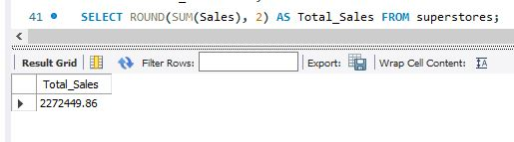
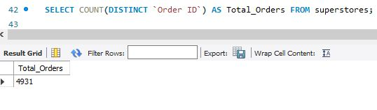
Key Insights:
Total Sales:
Total Orders:

Slide 4
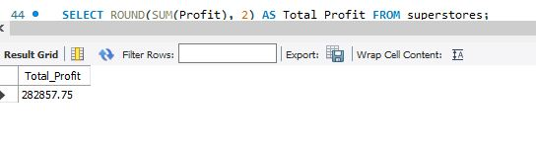
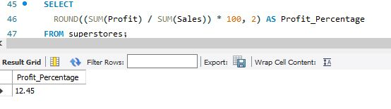
Total Profit:
Profit Percentage:

Slide 5
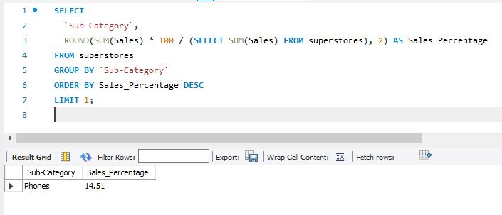
Top Product:

Slide 6
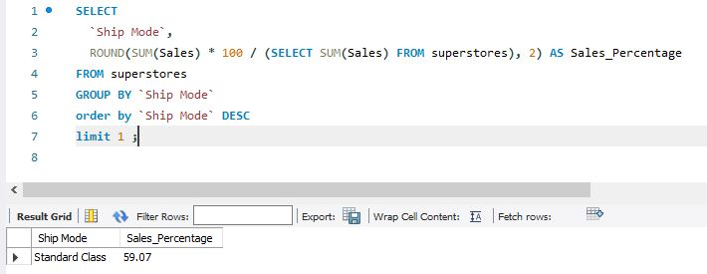
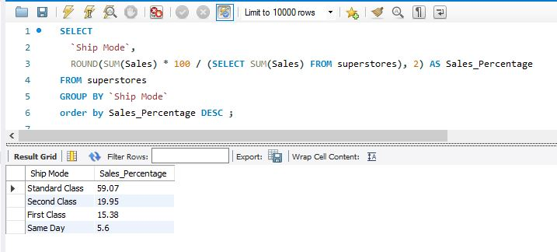
Most Preferred Ship Mode:
Total Ship Mode:

Slide 7
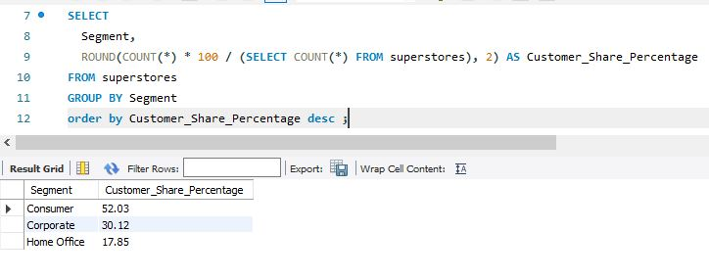
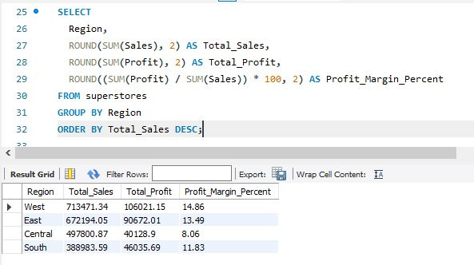
Customer Segments':
Region Wise:

Slide 8
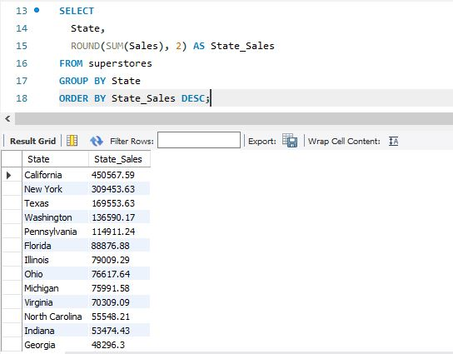
State Wise:

Slide 9
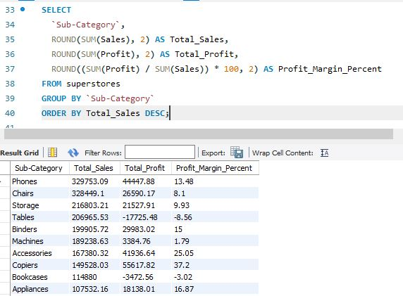
Subcategory Wise:

Slide 10
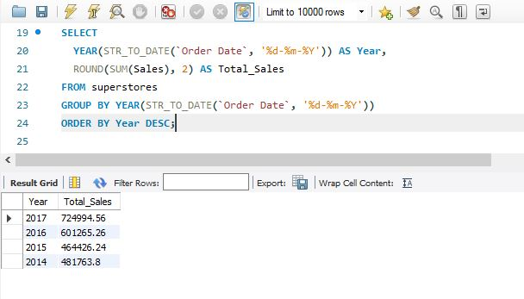
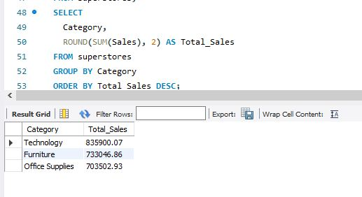
Year Wise:
Category Wise:

Slide 11
Insights from Superstore Dataset
Sales and Profit Overview
Sales are good in certain categories, but profitability is very uneven.
High sales areas like Furniture sometimes have low or negative profit margins.
Some sub-categories consistently show losses despite decent sales volumes (e.g., Tables, Bookcases).
2. Category and Sub-Category Performance
Top-selling categories:
Technology (Strong sales and good profit margins)
Office Supplies (High volume, but lower profit per unit)
Problematic categories:
Furniture (especially Tables and Bookcases showing losses)
Best-performing sub-categories:
Copiers, Phones, and Accessories in Technology (Very profitable)
Worst-performing sub-categories:
Tables, Bookcases, Supplies (often negative profits)

Slide 12
3. Regional Analysis
West and East regions: Strongest in both Sales and Profit.
South and Central regions: Struggle with lower profit margins even if sales are decent.
4. Customer Segment Insights
Corporate and Consumer segments bring the most revenue.
Home Office segment is less profitable and has higher return rates (more discounting and losses).
5. Discounting Impact
Heavy discounts often lead to profit losses.
Particularly in Furniture and Office Supplies, high discounts are killing margins.
There’s a clear negative correlation between discounts and profits.
6. Shipping Modes
Same Day Shipping is costlier and less profitable.
Standard Class Shipping gives better profitability overall.

Slide 13
Recommendations to Improve Sales and Profits
🚀
Reconsider or Optimize Problem Sub-Categories
Reduce focus on low-profit items like Tables and Bookcases.
Negotiate better supplier deals or increase prices for those sub-categories.
Consider phasing out or bundling these products to reduce their losses.
2. Control Discounts
Implement stricter discounting policies.
Target discounts only on high-margin items to boost profits without harming revenue.
Analyse discount thresholds — above a certain % discount, many deals become loss-making.

Slide 14
3. Regional Sales Strategy
Invest more in West and East regions (where customers are profitable).
Develop regional promotions tailored for South and Central to increase loyalty without heavy discounting.
4. Focus on High-Profit Sub-Categories
Prioritize marketing for Technology products (Phones, Accessories, Copiers).
Upsell or cross-sell high-margin accessories when selling lower-margin items.
5.Shipping Strategy
Promote Standard Class Shipping more often (especially for Home Office customers).
Introduce free shipping thresholds to push up order sizes without killing profit margins.

Slide 15
6. Customer Segment Focus
Home Office customers are less profitable — consider:
Smaller, specific promotions for this group.
Offer bundles rather than discounting single products.
7.Data Maintenance
Some product categories and sub-categories had missing or inconsistent data.
Regular data audits can help identify hidden issues earlier and improve decision-making.

Slide 16


